Slide 1
Earthquakes
Natural Disasters in Canada

Slide 2
Earthquakes
Most earthquakes are caused by the movement of tectonic plates
Tectonic plates are large, broken pieces of the earth's outer crust
These plates are always moving but very slowly, roughly a few centimeters a year

Slide 3
Earthquakes
Earthquakes typically occur when tectonic plates either move apart, slide past each other or push against one another
Divergent: the plates move apart
Convergent: the plates push against one another
Transform: the plates slide past each other

Slide 4
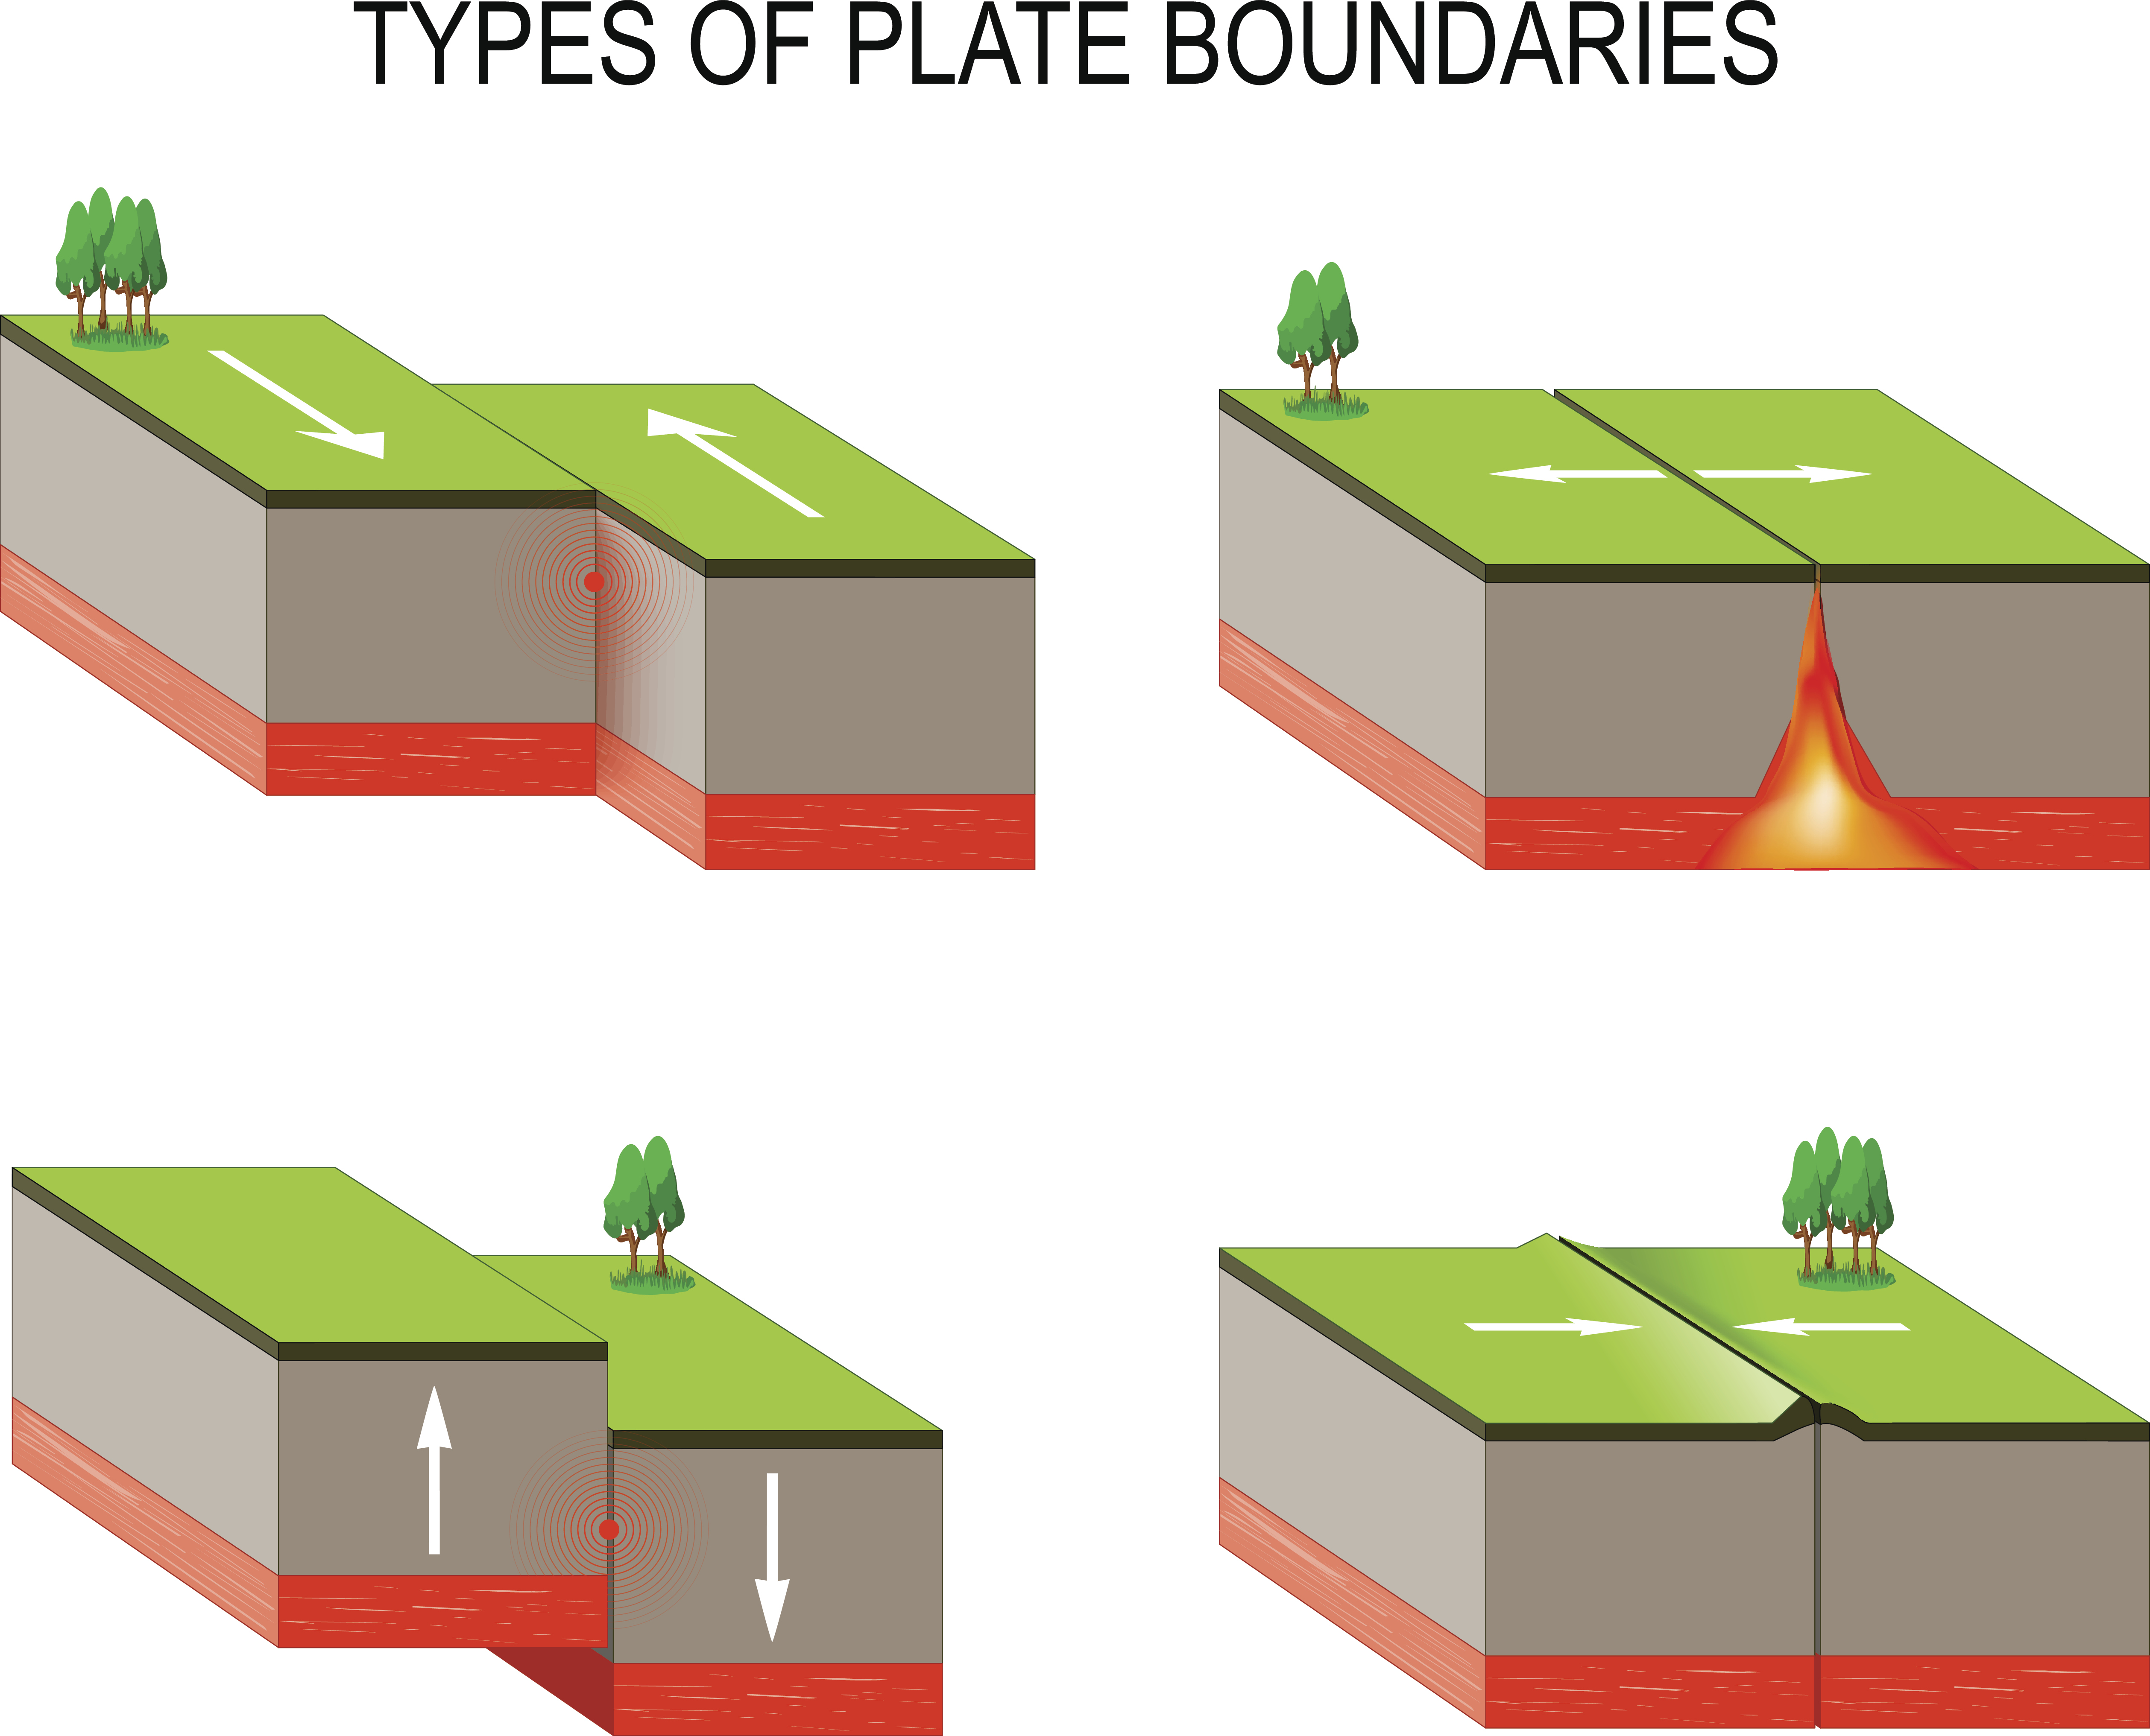

Slide 5
Earthquakes
Fault lines are long cracks in the surface of the earth
When tectonic plates and fault lines interact, stress and pressure build up which causes the rock to crack and shift
This releases a lot of stored up energy
This burst of energy causes the ground to shake which is what we feel as an earthquake

Slide 6
Earthquakes
The focus is the area underground where the rock breaks
The epicenter is the spot in the ground directly above the focus

Slide 7
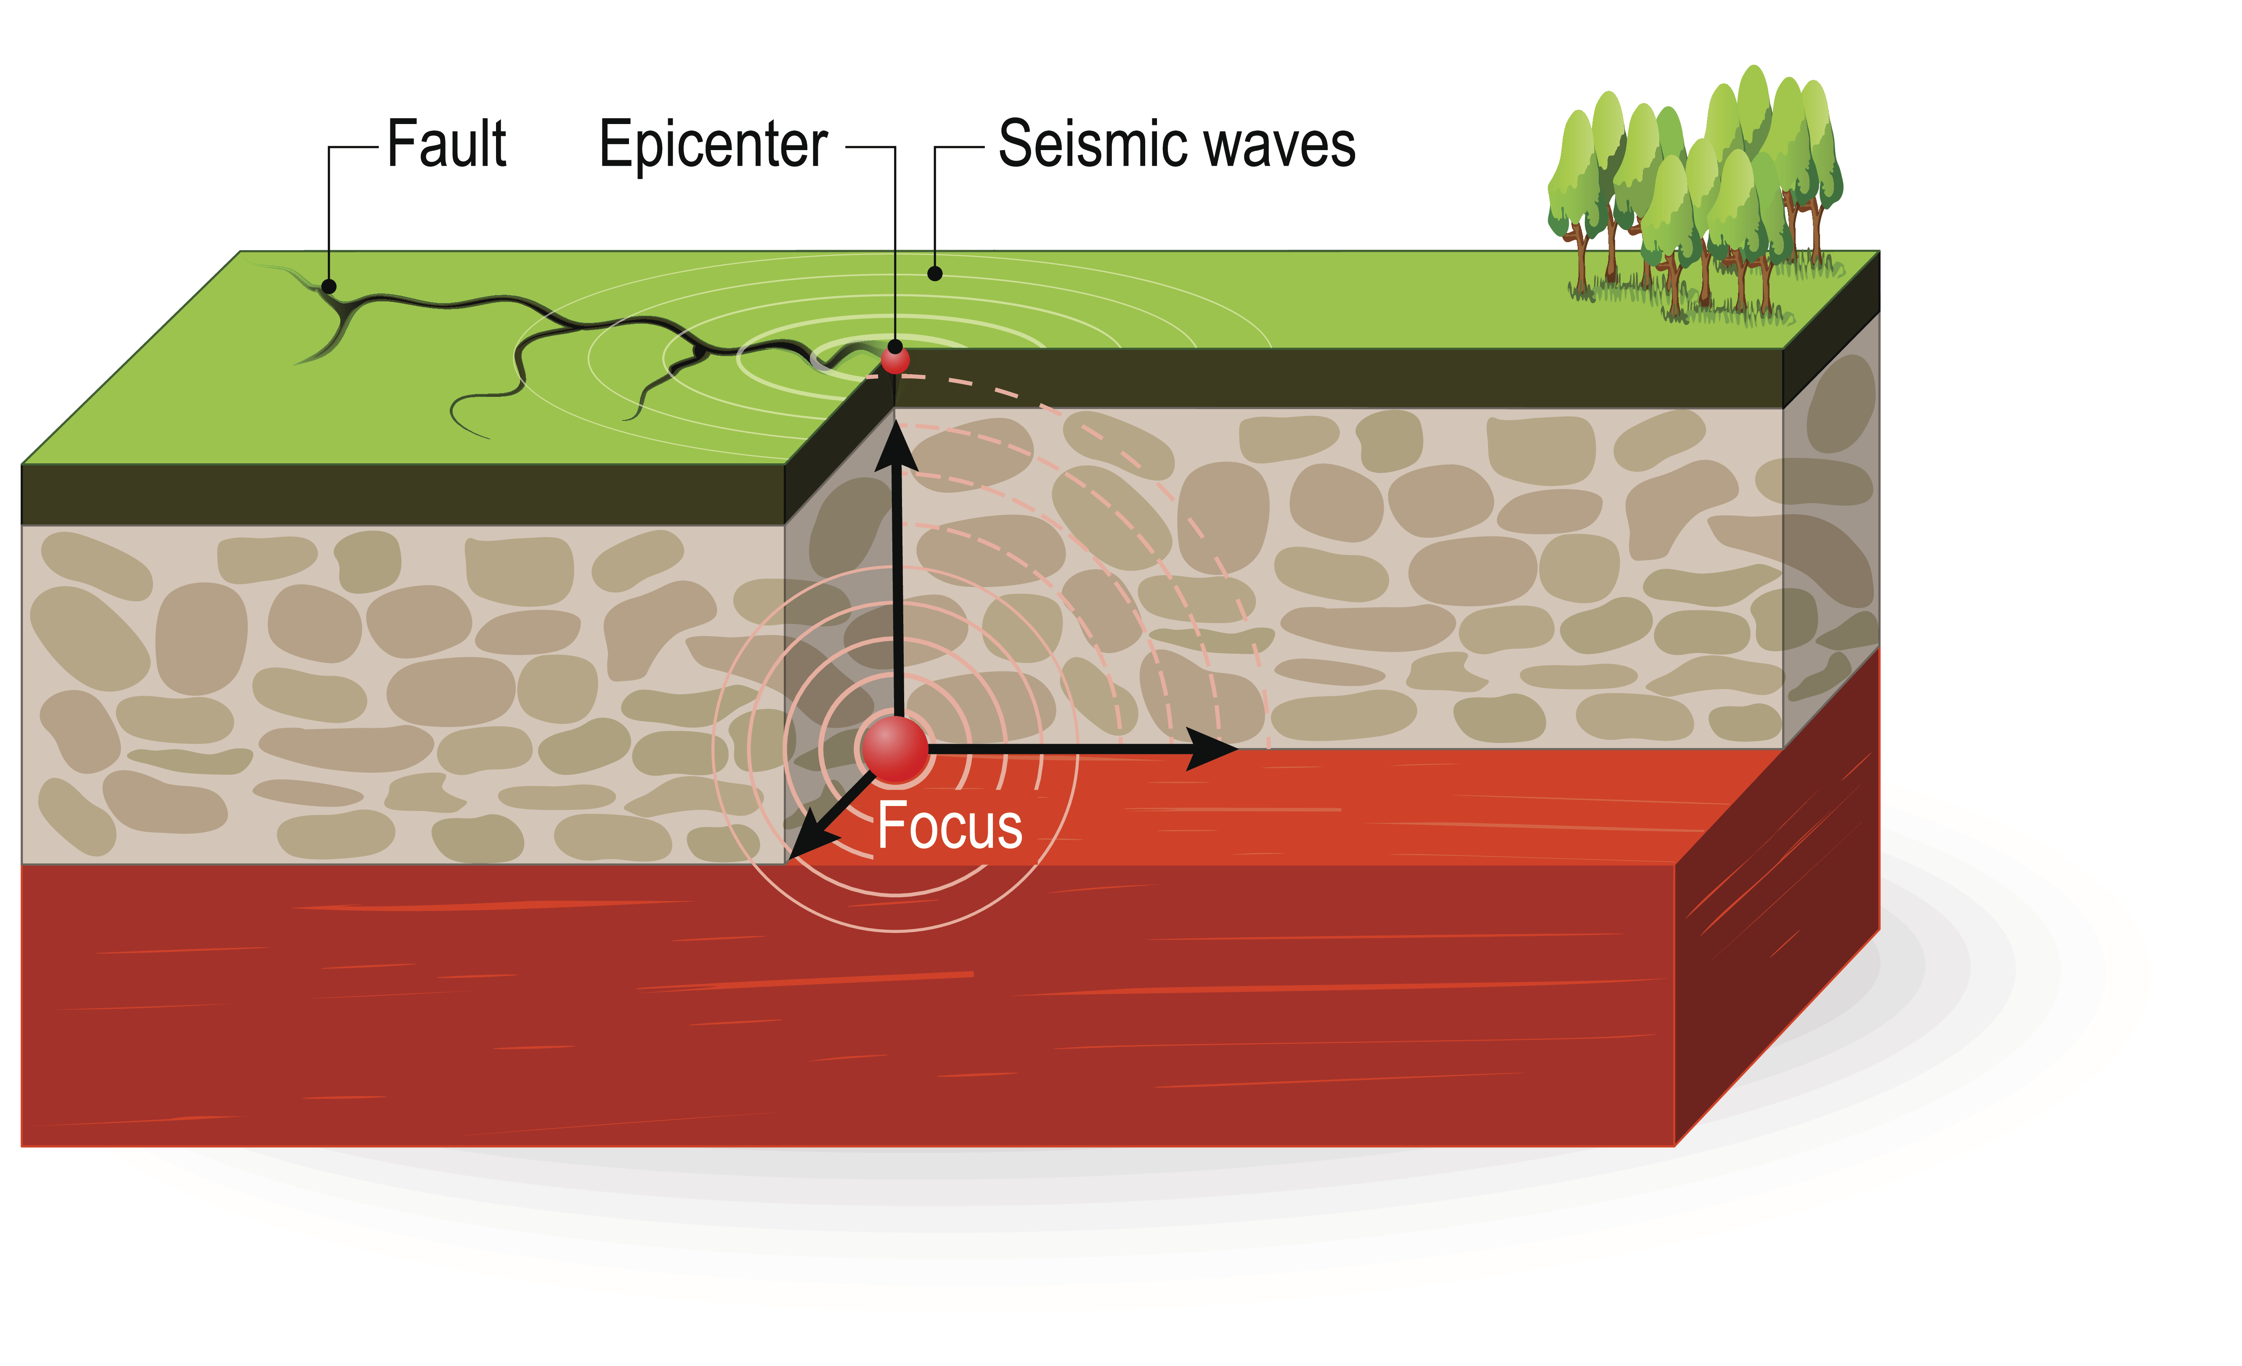

Slide 8
Measuring Earthquakes
The Richter scale is the tool for measuring the amount of energy that is released during an earthquake
It is a scale ranging from 1 to 10 where the increase of one whole number is 10x the magnitude
For example, an earthquake that measures 7.0 is 100 times stronger than one that measures 5.0

Slide 9
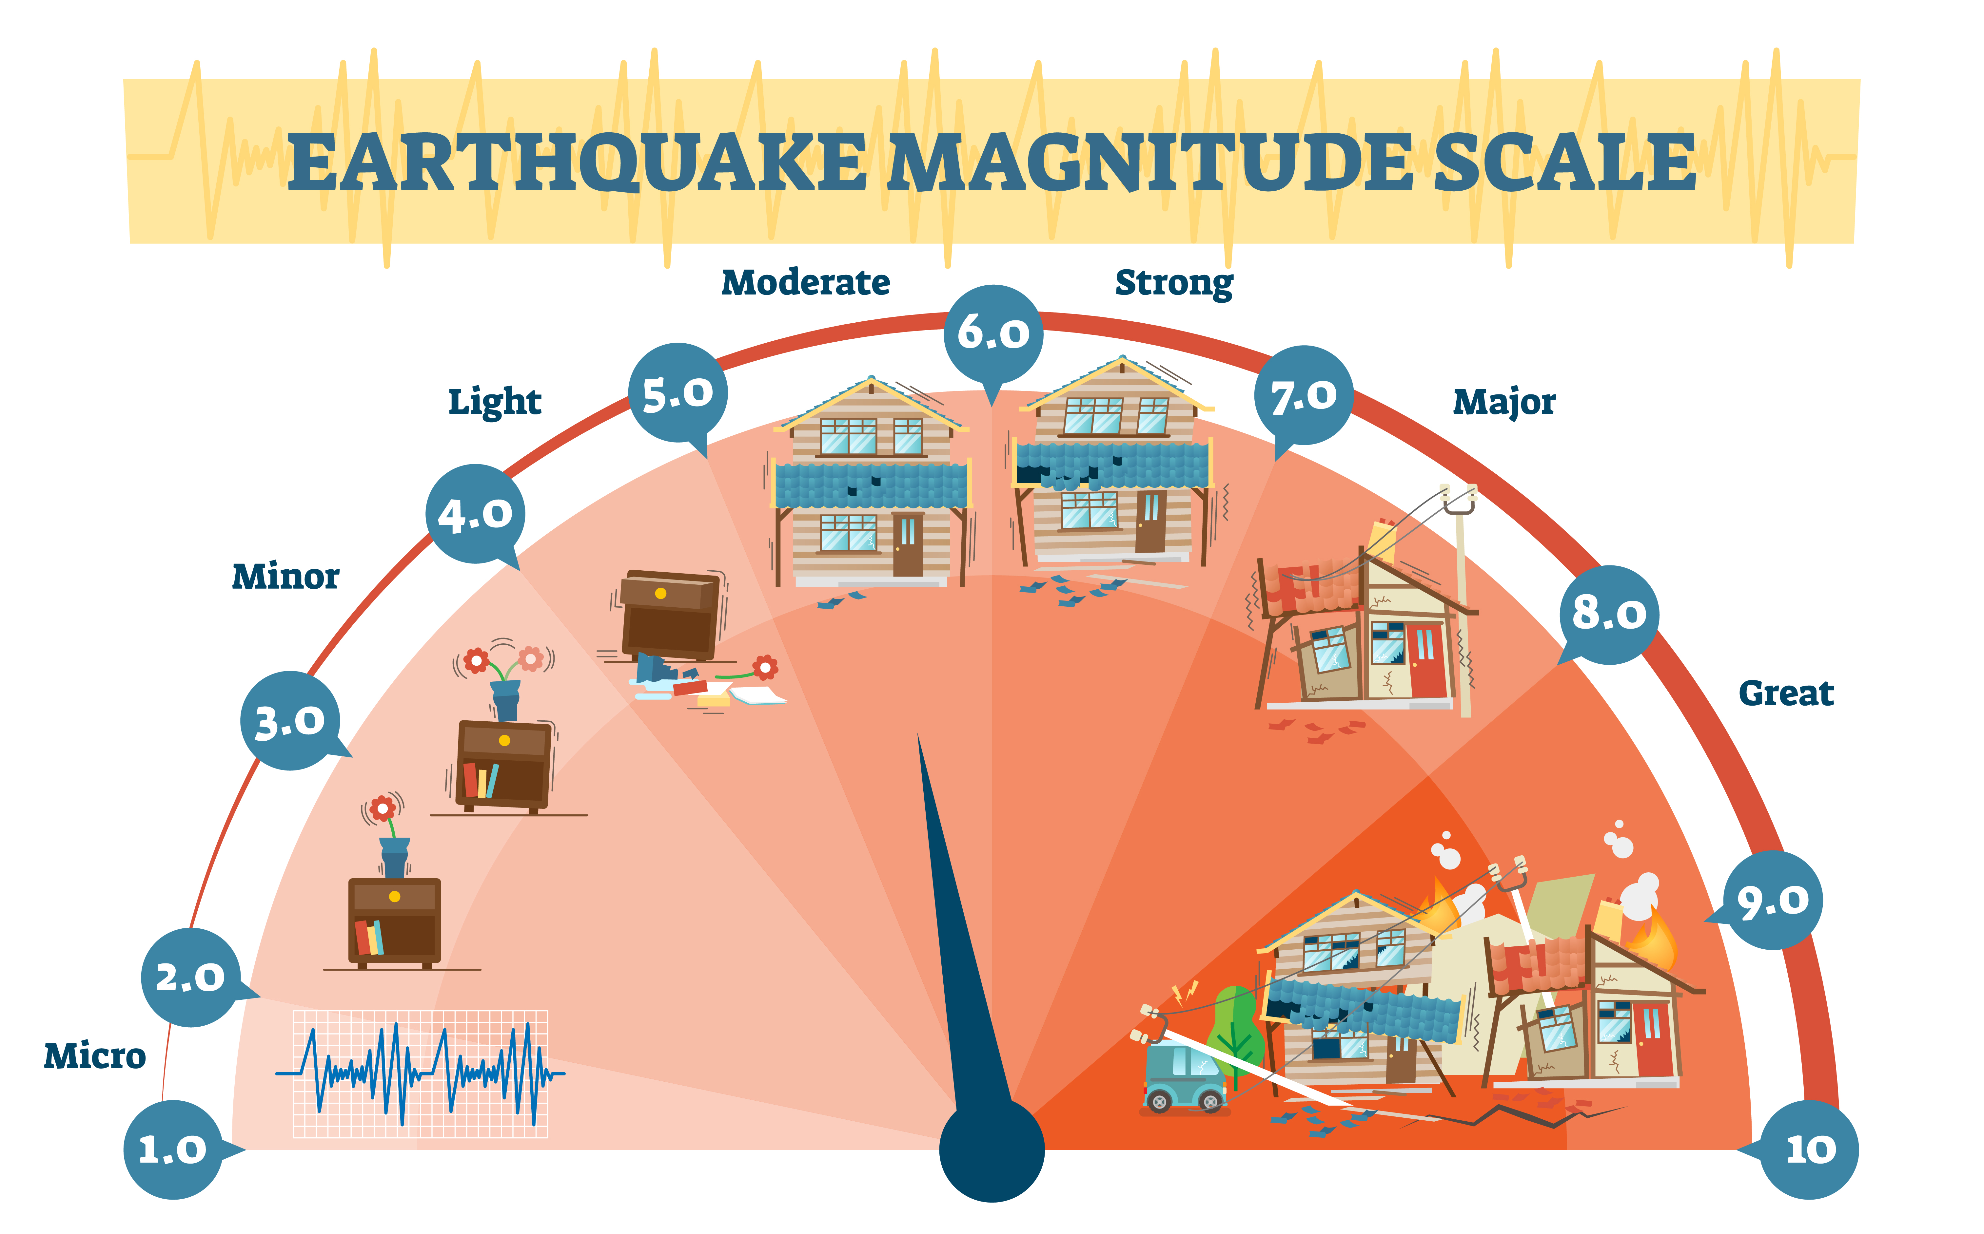

Slide 10
Measuring Earthquakes
Scientists can detect the magnitude of earthquakes using a seismograph which measures the vibrations in the ground
These vibrations are called seismic waves

Slide 11
Measuring Earthquakes
The height of the largest waves is the measurement of the size of the earthquake
The result is a seismogram which is a series of wavy lines that can help scientists record the location, intensity, and duration of the earthquake

Slide 13
Predicting Earthquakes
Using historical data and measurements of ongoing tectonic plate movements, scientists can hypothesize how likely an earthquake will happen in the future
Engineers strive to predict the magnitude of earthquakes to warn people of potential danger
Building, bridges and other structures are designed and built to protect people from the devastating effects of earthquakes

