Slide 1
wildfires
Natural Disasters

Slide 2
Ontario Forest Fires
As of June 2nd, 2025, there have been 135 forest fires
In 2024, there were a total of 77 forest fires
The 10-year average is 112 forest fires
See the Government of Ontario website for up-to-date information:
https://www.ontario.ca/page/forest-fires

Slide 3
Wildfires
What are some of the different environmental and social effects of wildfires in Canada?

Slide 4
Wildfires
Damage ecosystems
Pollute the air
Impact water quality
Contribute to soil erosion
Impact climate change by releasing large amounts of carbon dioxide into the air
Cause long-terms health problems (respiratory and cardiovascular)
Cause mental health effects both emotional and psychological
Economical losses
Property damage

Slide 5
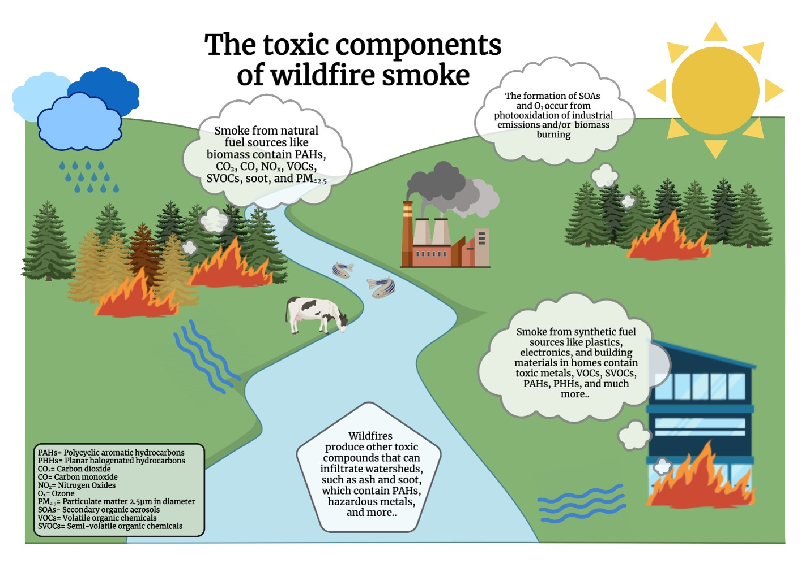
https://environmentalhealth.ucdavis.edu/wildfires/environmental-health-impacts

Slide 6
Wildfires
Three elements are needed to start a fire:
Fuel
Oxygen
Heat

Slide 7
https://www.ontario.ca/page/wildland-fire-behaviour

Slide 8
Element Sources
Fuel sources include vegetation and man-made structures
Oxygen is a component of air making up 21% of the atmosphere
Heat sources include lightning and human activities

Slide 9
Elements of Wildfires
If one of these elements is not present, the fire will not burn
The goal of firefighters is to remove at least one of the elements to control and stop the forest fire from spreading

Slide 10
Controlling Wildfires
Cooling the air with water will remove the heat source
Smothering the fire with soil or water will remove the oxygen source
Removing access to vegetation or other structures with water or flame retardant on unburned sections will remove the fuel source

Slide 11
Influencing Factors
The main factors that influence the spread of wildfires are:
Fuel
Topography
Weather

Slide 12
https://www.ontario.ca/page/wildland-fire-behaviour

Slide 13
Fuel
Types of fuel include grasses, deciduous and coniferous types of vegetation
Grasses and small branches burn quicker than large pieces of wood
Horizontal spacing is the spacing of the fuel lying on the ground
If fuel is close together, the fire will spread faster
If fuel is scattered and spaced apart by a natural barrier, the fire will spread more slowly

Slide 14
Topography
Aspect: describes which direction that the slope is facing
If it is facing south, it will be much hotter and therefore the fuels will be warmer and drier making it easier to burn
Slope: a slant in the earth’s surface that is either upward or downward
If the fire is burning up a slope, vertically, it will burn faster because the fuel receives heat, drying it out before the flames reach it
If there are water bodies nearby such as lakes, rivers and ponds, they can slow or stop the spread of the fire

Slide 15
https://extension.oregonstate.edu/catalog/pub/em-9341-fire-behavior

Slide 16
Weather
Factors that affect fire behaviour include:
Humidity levels
Precipitation
Temperature
Wind
Wind is one of the greatest factors that affect fire which affects direction and rate of speed at which fire spreads
It also affects the speed of the fire and blowing embers to surrounding areas

Slide 17
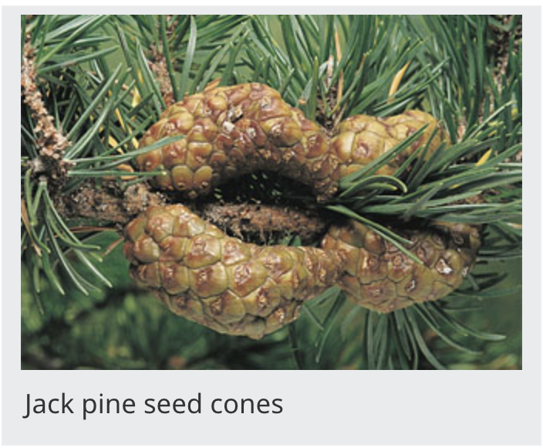
Natural Roles of Wildfires
Forest fires do have an important ecological role by maintaining biodiversity and creating different landscapes
Jack pine for example need fire to reproduce
Extreme heat is the only way that their cones will open to disperse their seeds
https://natural-resources.canada.ca/forest-forestry/wildland-fires/fire-ecology

Slide 18
Controlled Burns
Controlled burns are important for forest and wildlife management.
These highly regulated burns can assist in:
Removing insect pests and diseases
Remove undesirable plants that compete for soil nutrient
Clear areas to prepare for planting
Enhance wildlife habitat

Slide 19
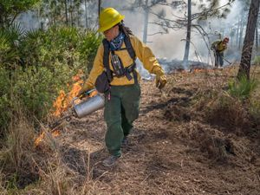
https://www.nature.org/en-us/about-us/where-we-work/united-states/oregon/controlled-burns/

