Slide 1
Natural disasters in Canada
Grade 9 Exploring Canadian Geography

Slide 2
Natural Disasters in Canada
Examine the photos in the following slides and attempt to determine the following:
What happened?
Where in Canada do you think this happened?
Who was affected?
What do you think caused it?
Was it caused by geological or climatic factors or both?

Slide 3
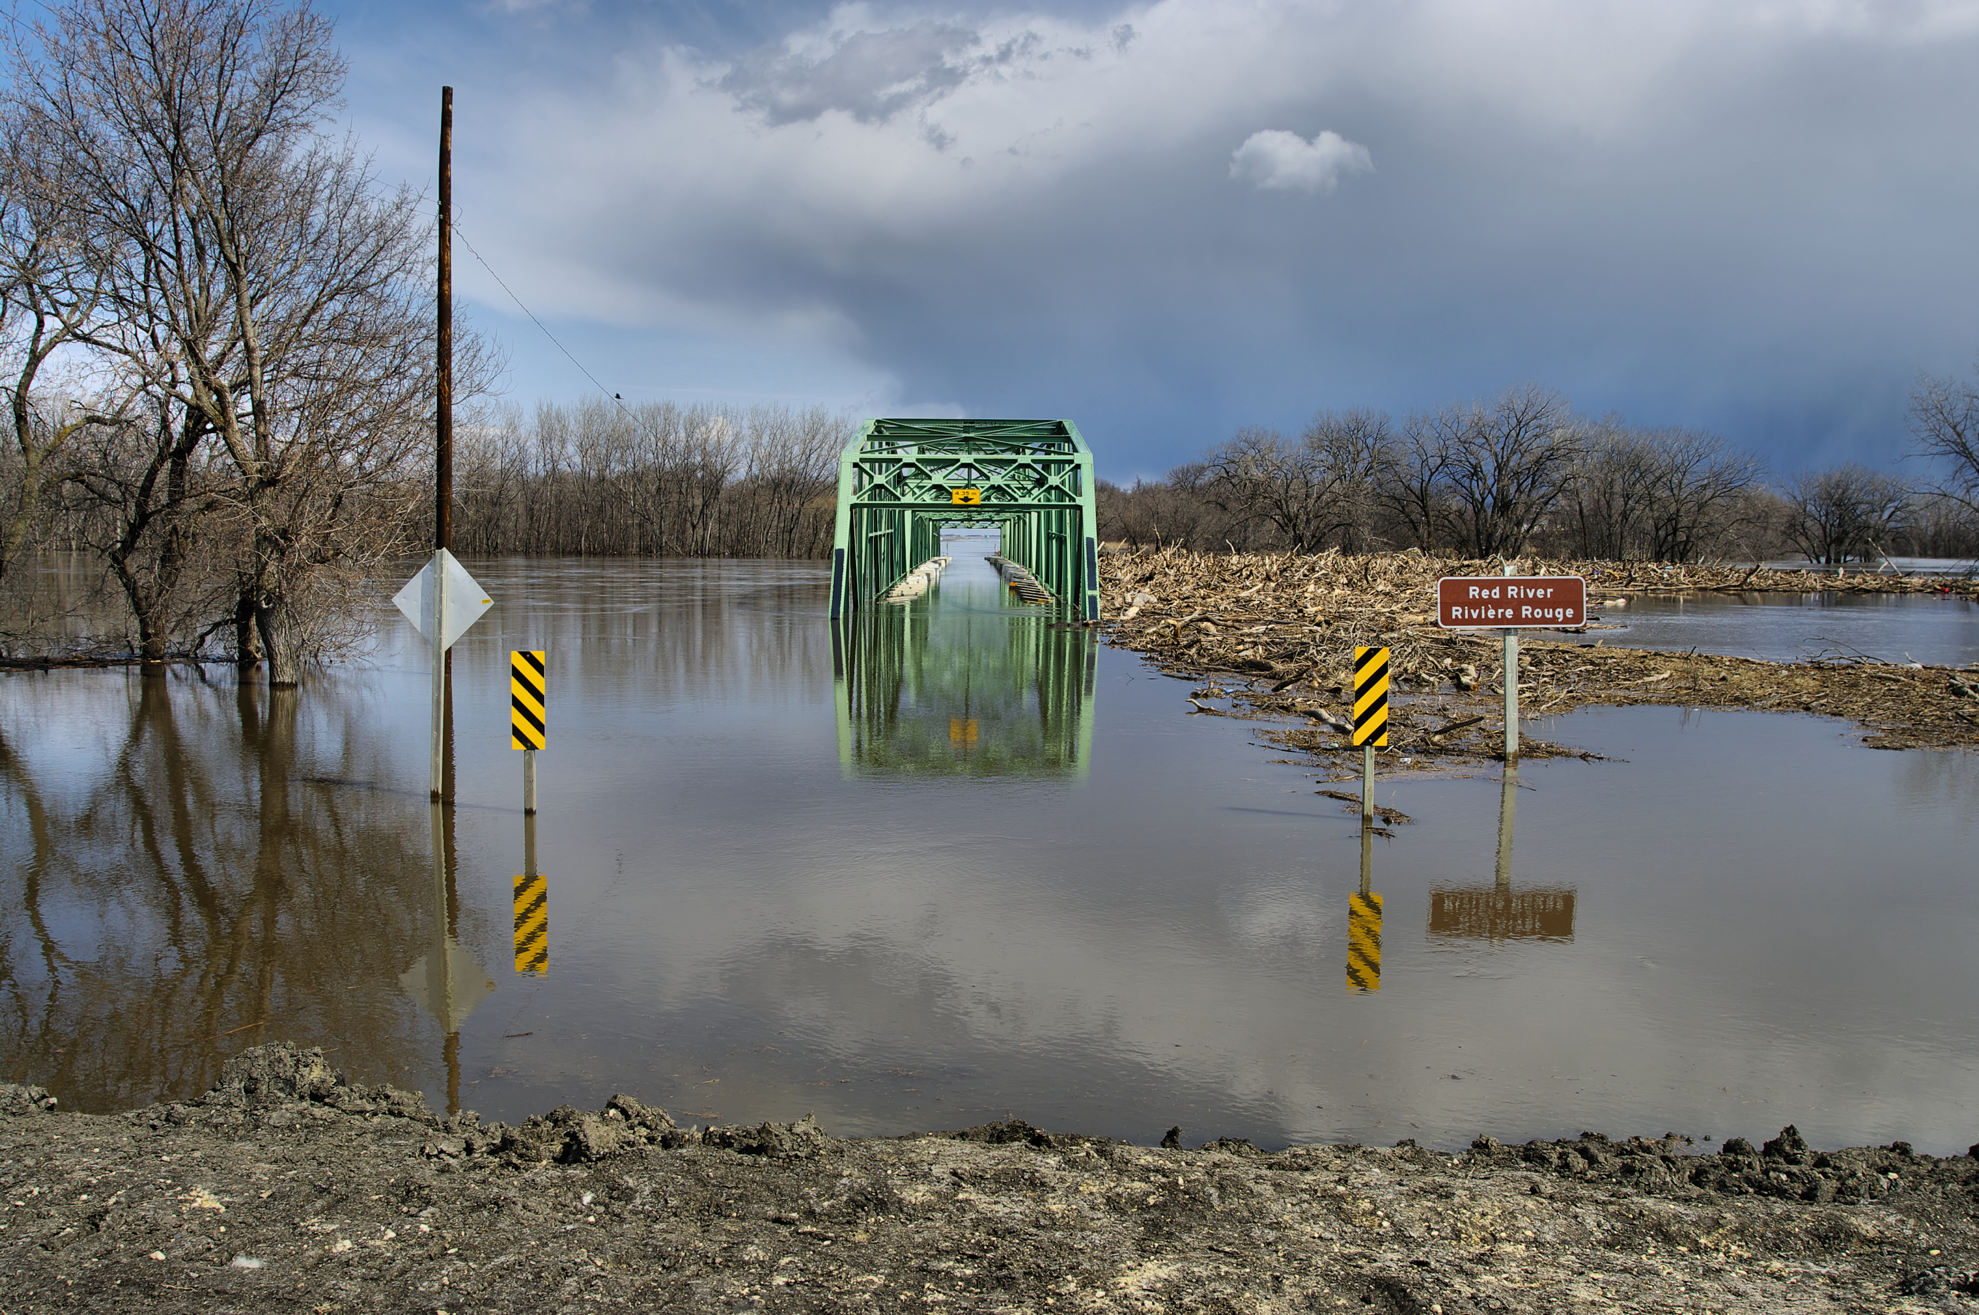
Natural Disasters in Canada

Slide 4
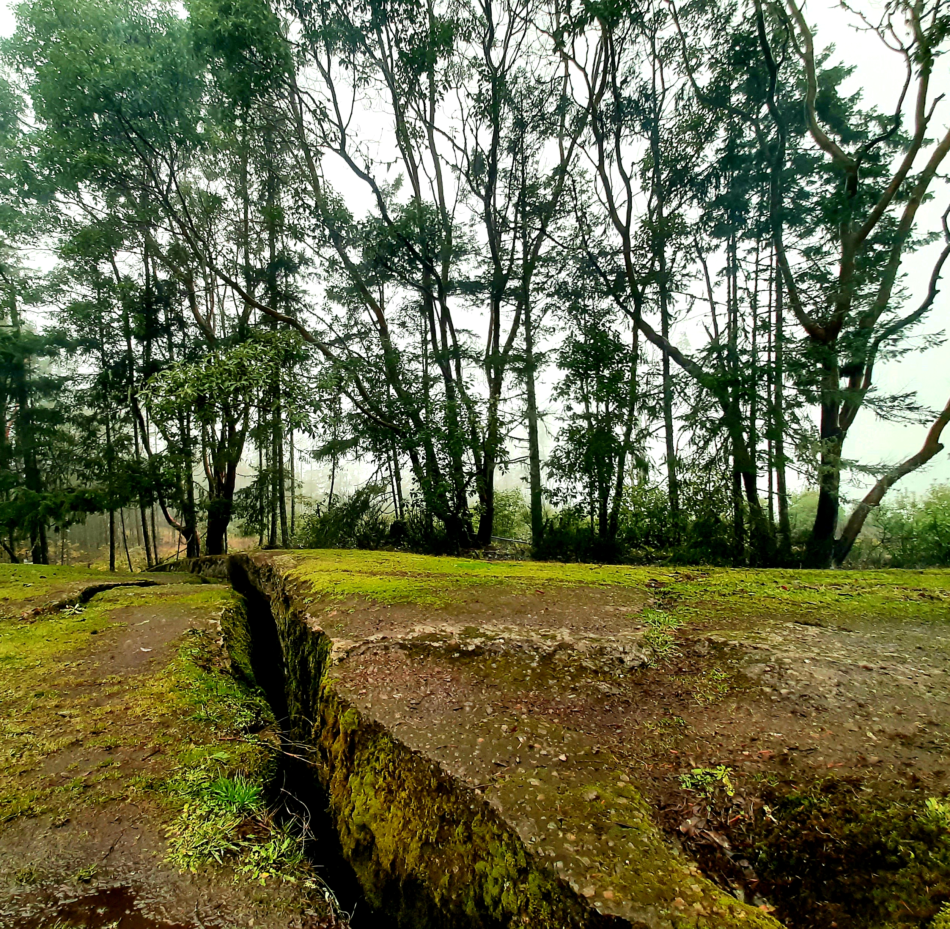
Natural Disasters in Canada

Slide 5
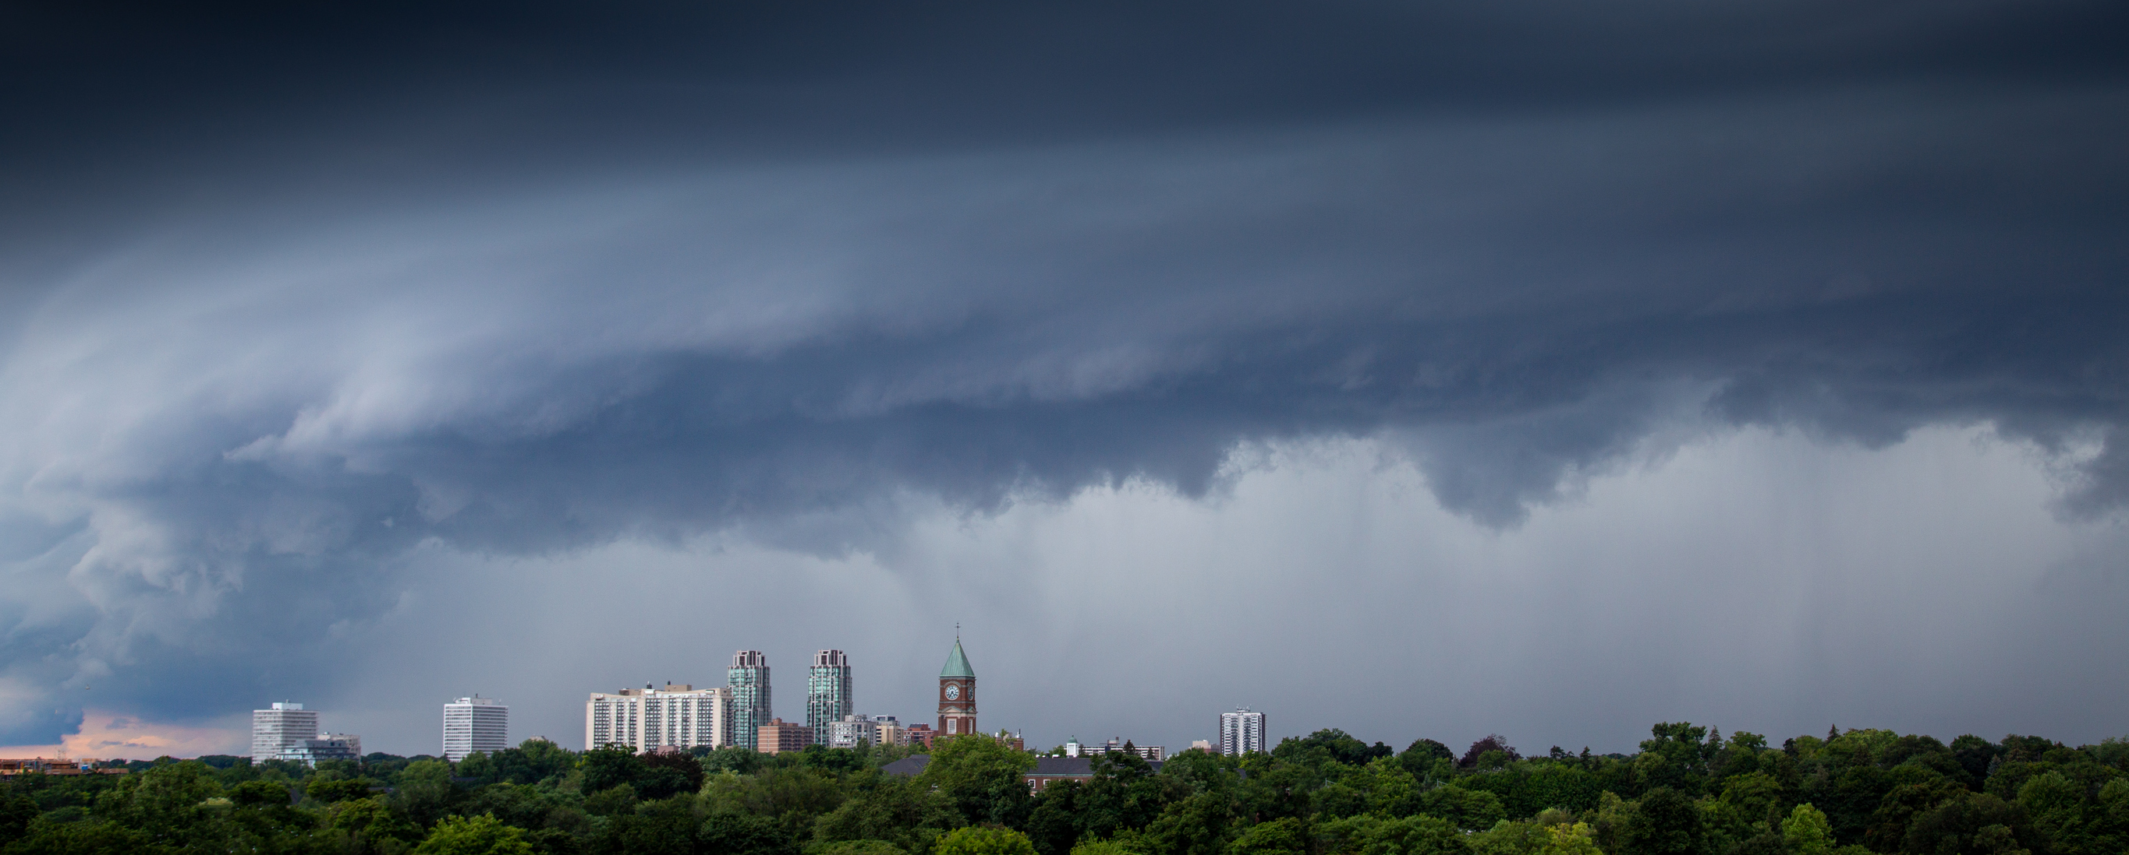
Natural Disasters in Canada

Slide 6
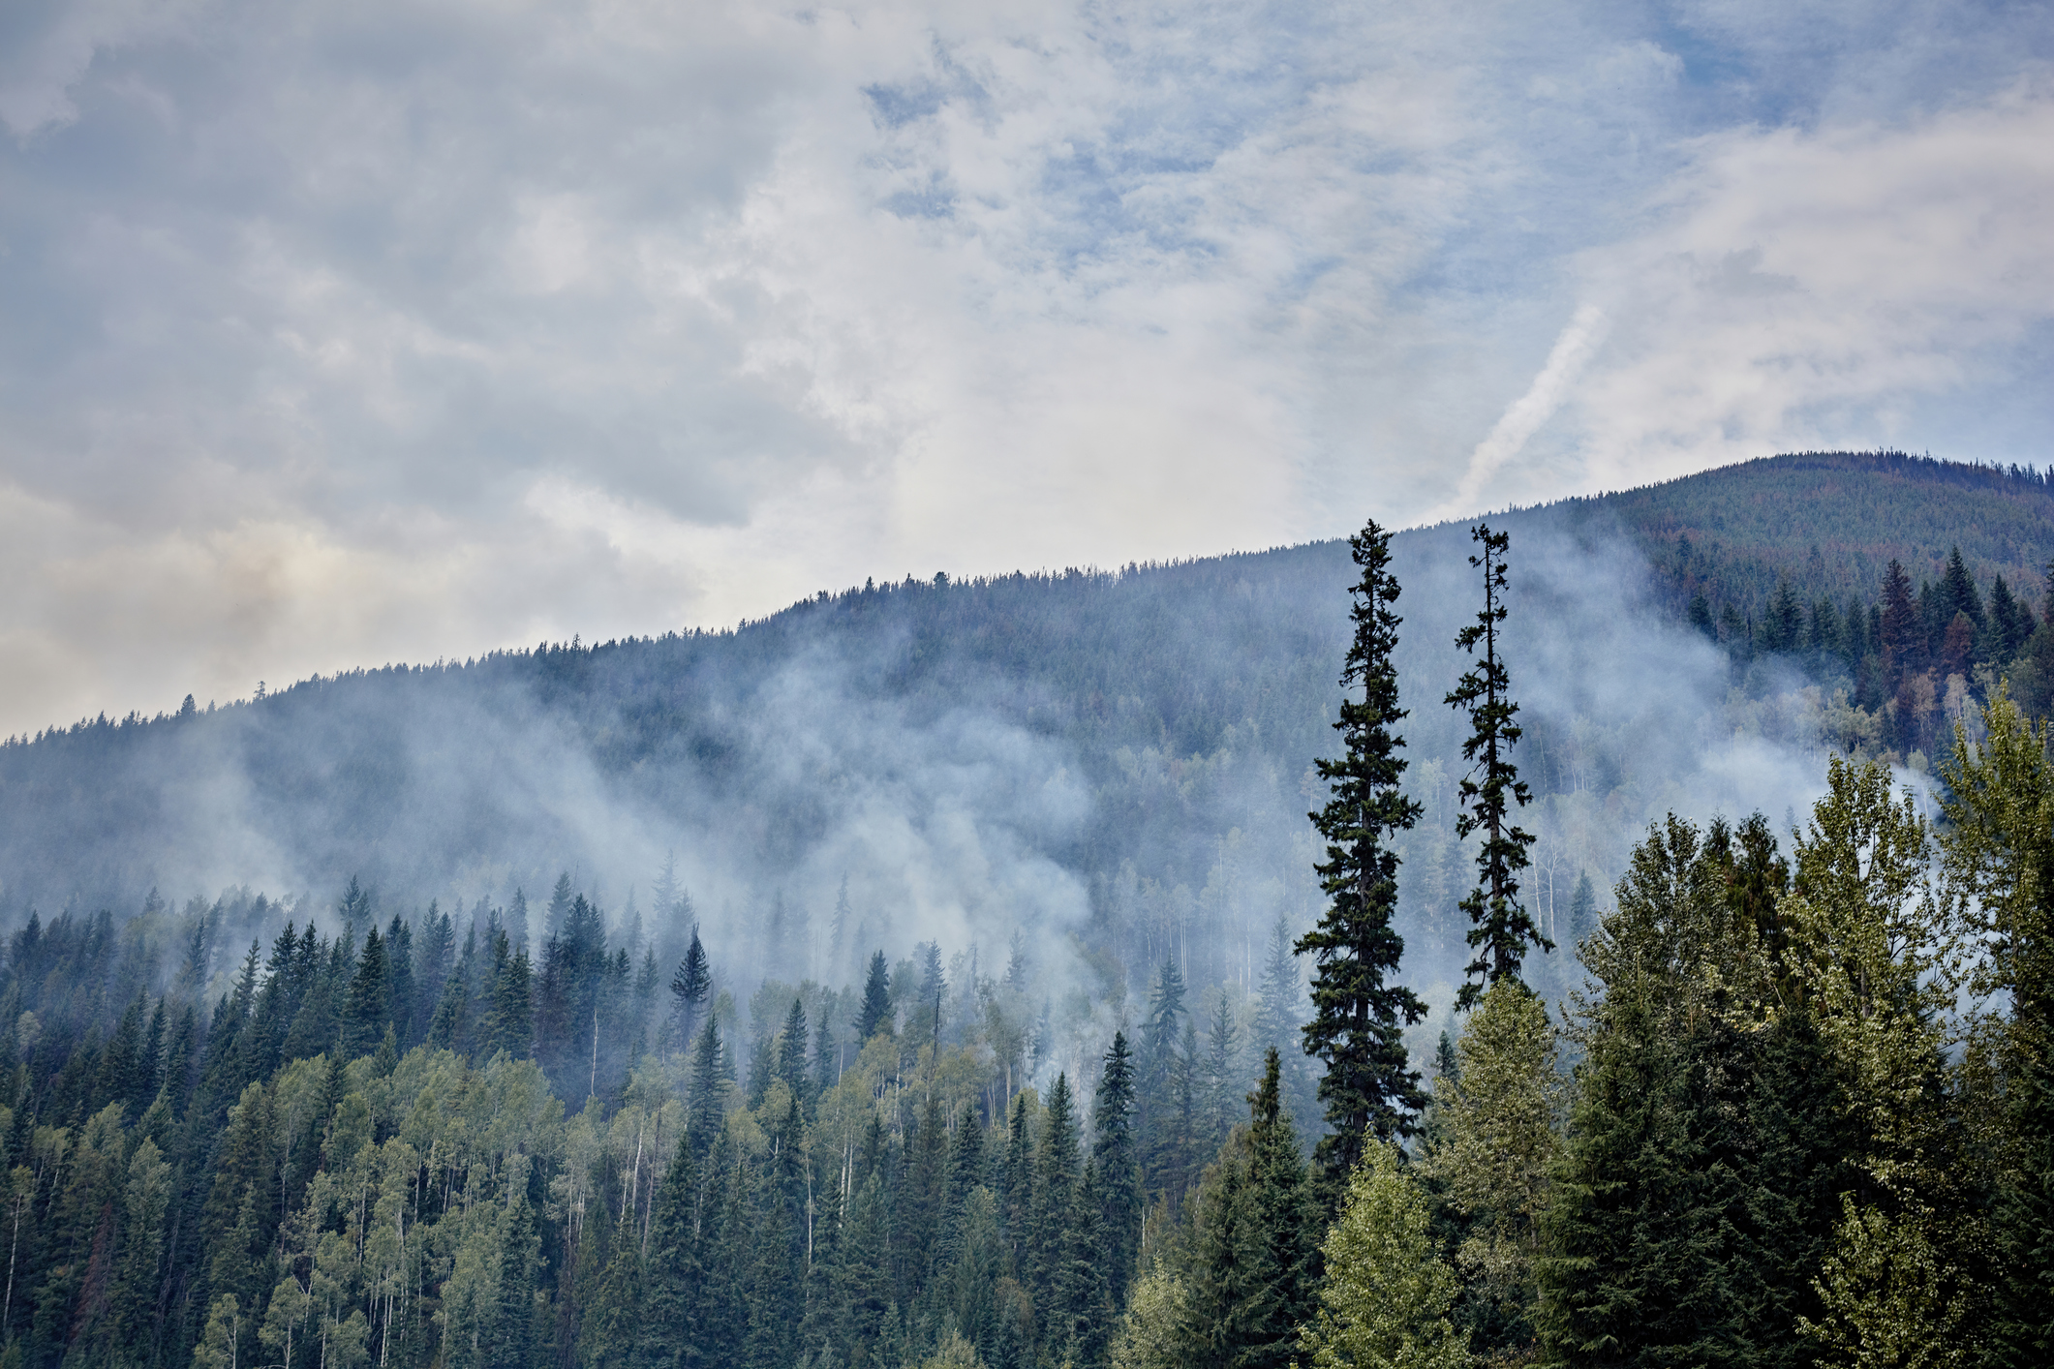
Natural Disasters in Canada

Slide 7
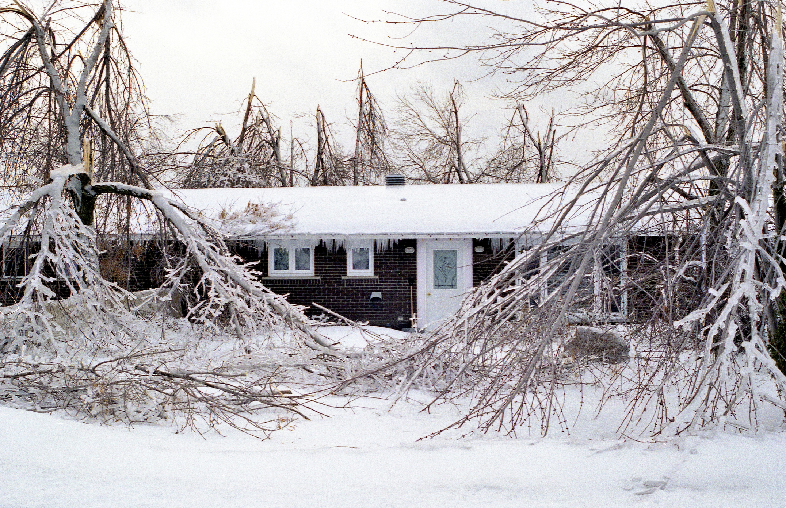
Natural Disasters in Canada

Slide 8
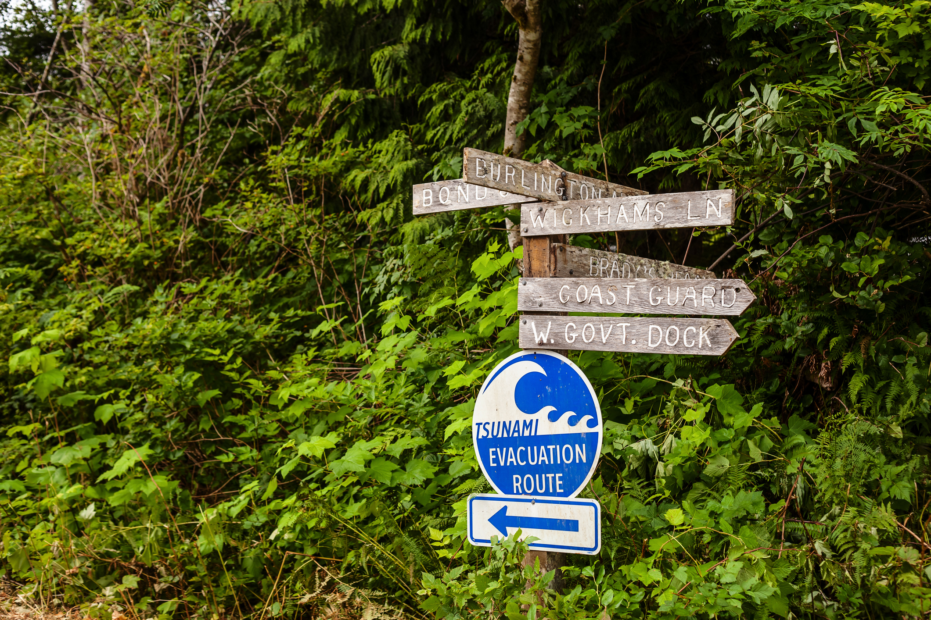
Natural Disasters in Canada

Slide 9
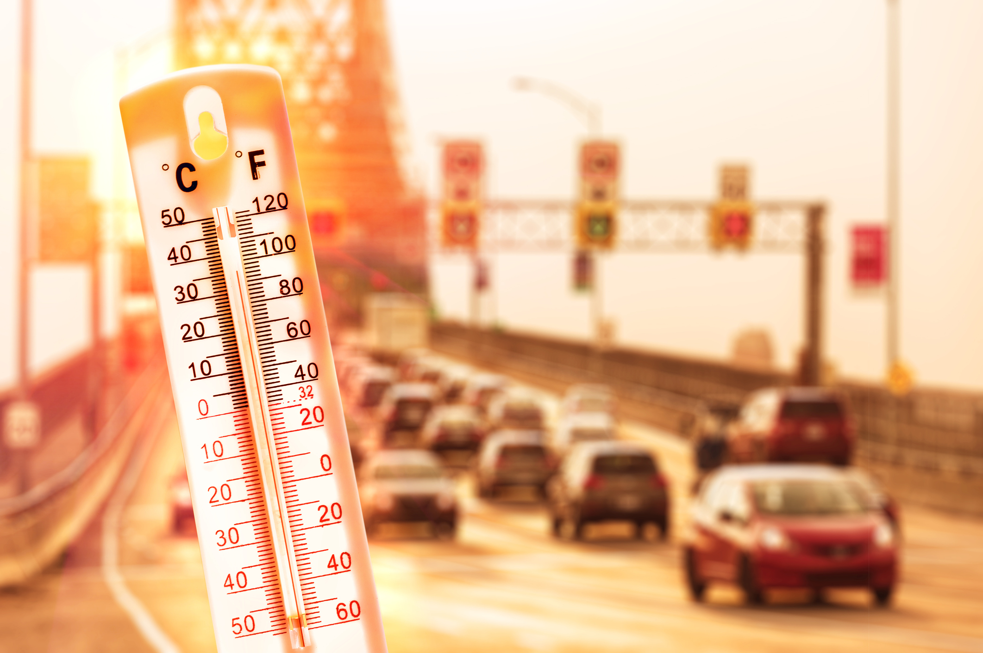
Natural Disasters in Canada

Slide 10
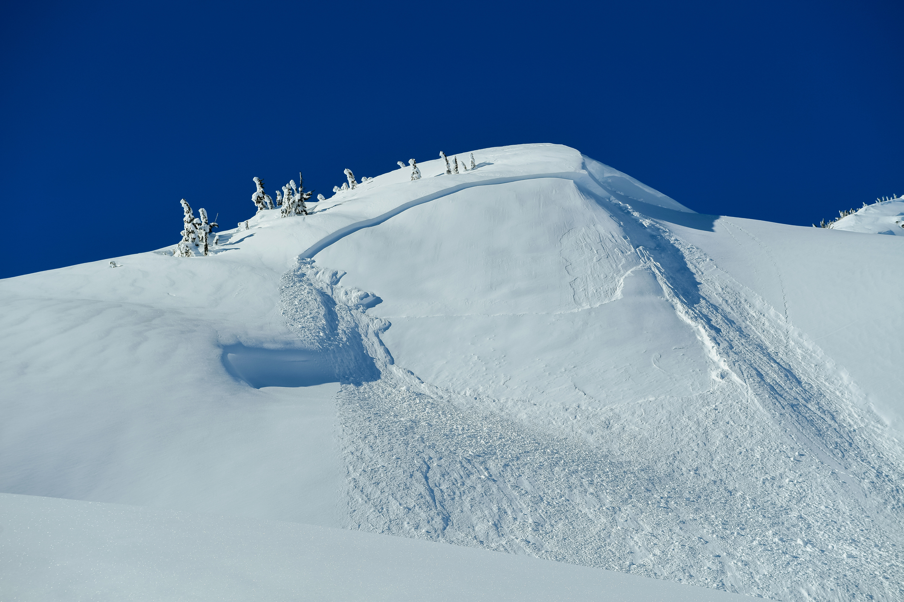
Natural Disasters in Canada

