Slide 1
Natural disasters in Canada
Characteristics of Canada's Natural Environment and the Impact of Physical Processes

Slide 2
Natural Disasters in Canada
Examine the photos in the following slides and attempt to determine the following:
What happened?
Where in Canada do you think this happened?
Who was affected?
What do you think caused it?
Was it caused by geological or climatic factors or both?

Slide 3
Natural Disasters in Canada
https://globalnews.ca/news/5216176/worst-floods-canadian-history/

Slide 4
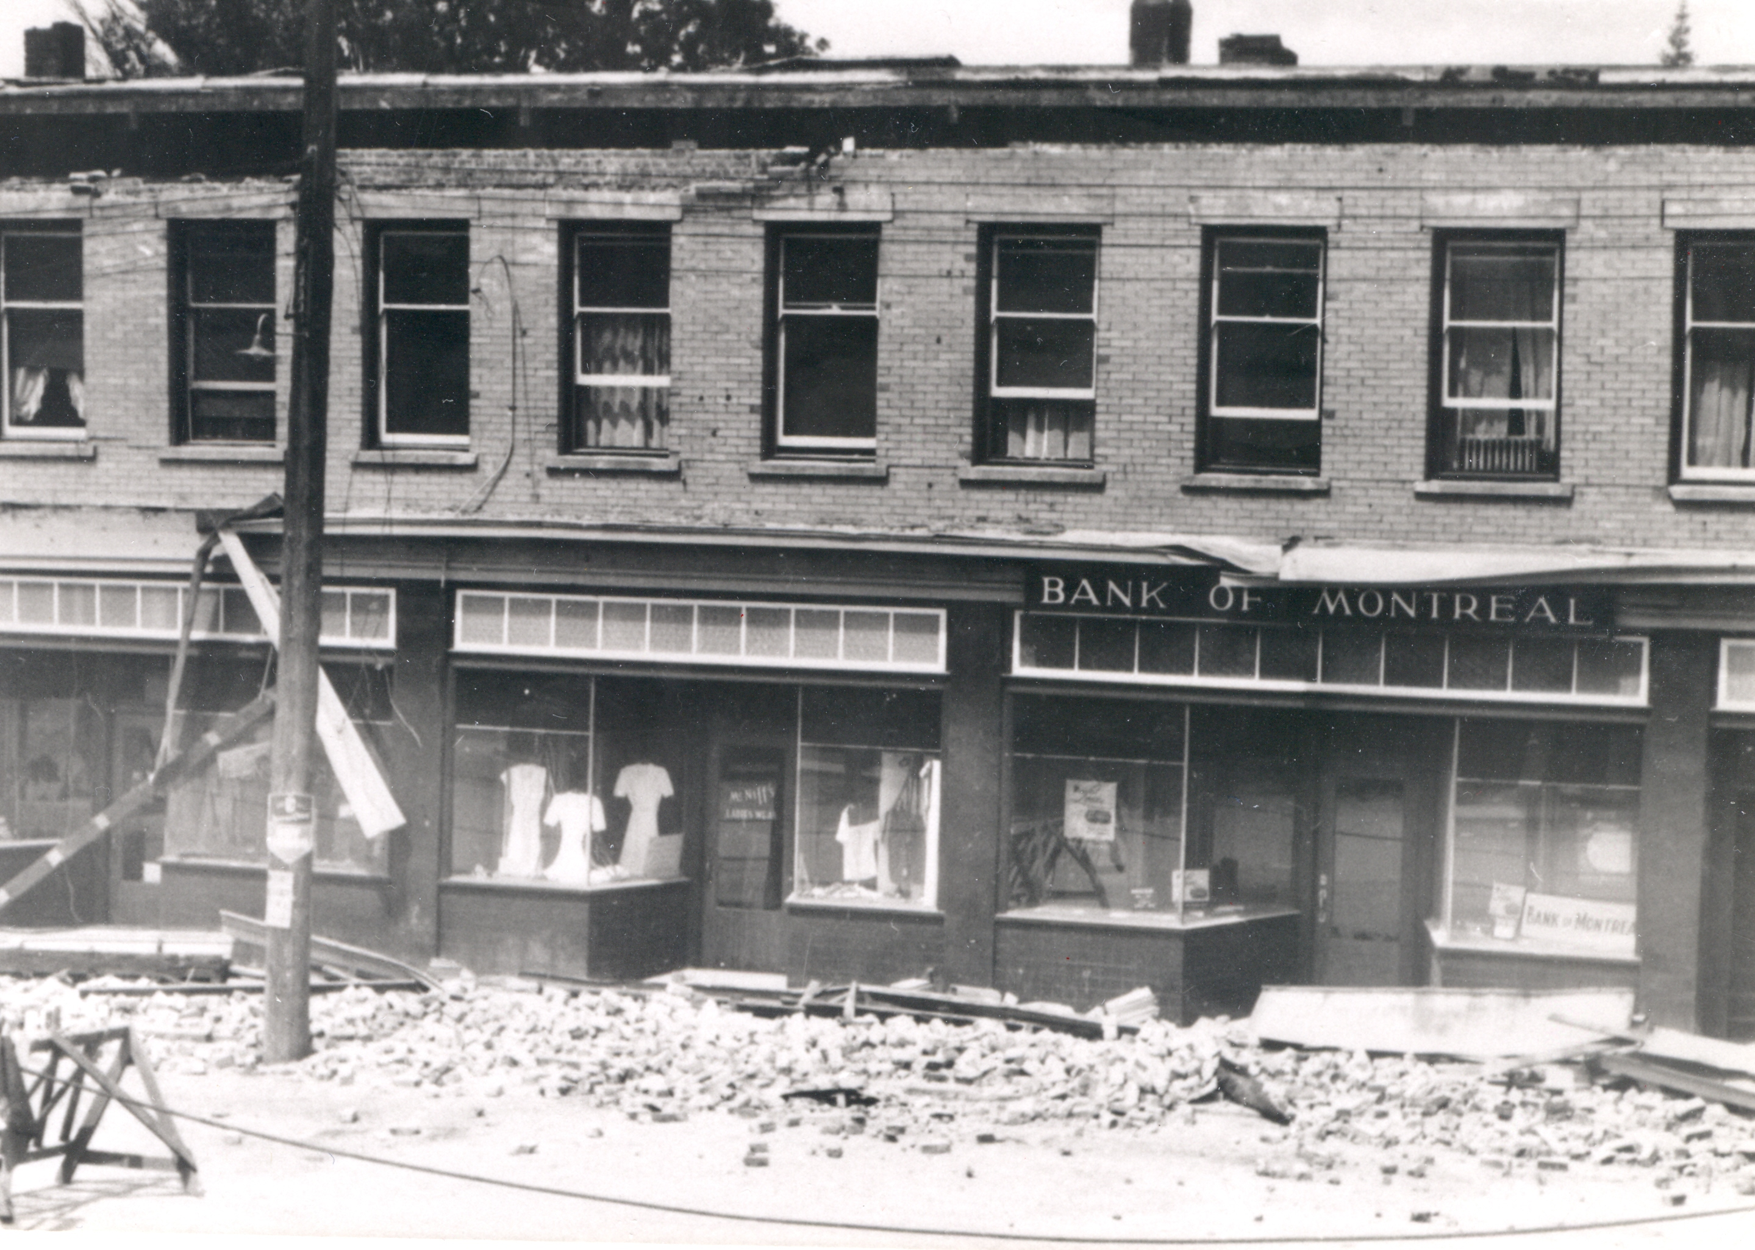
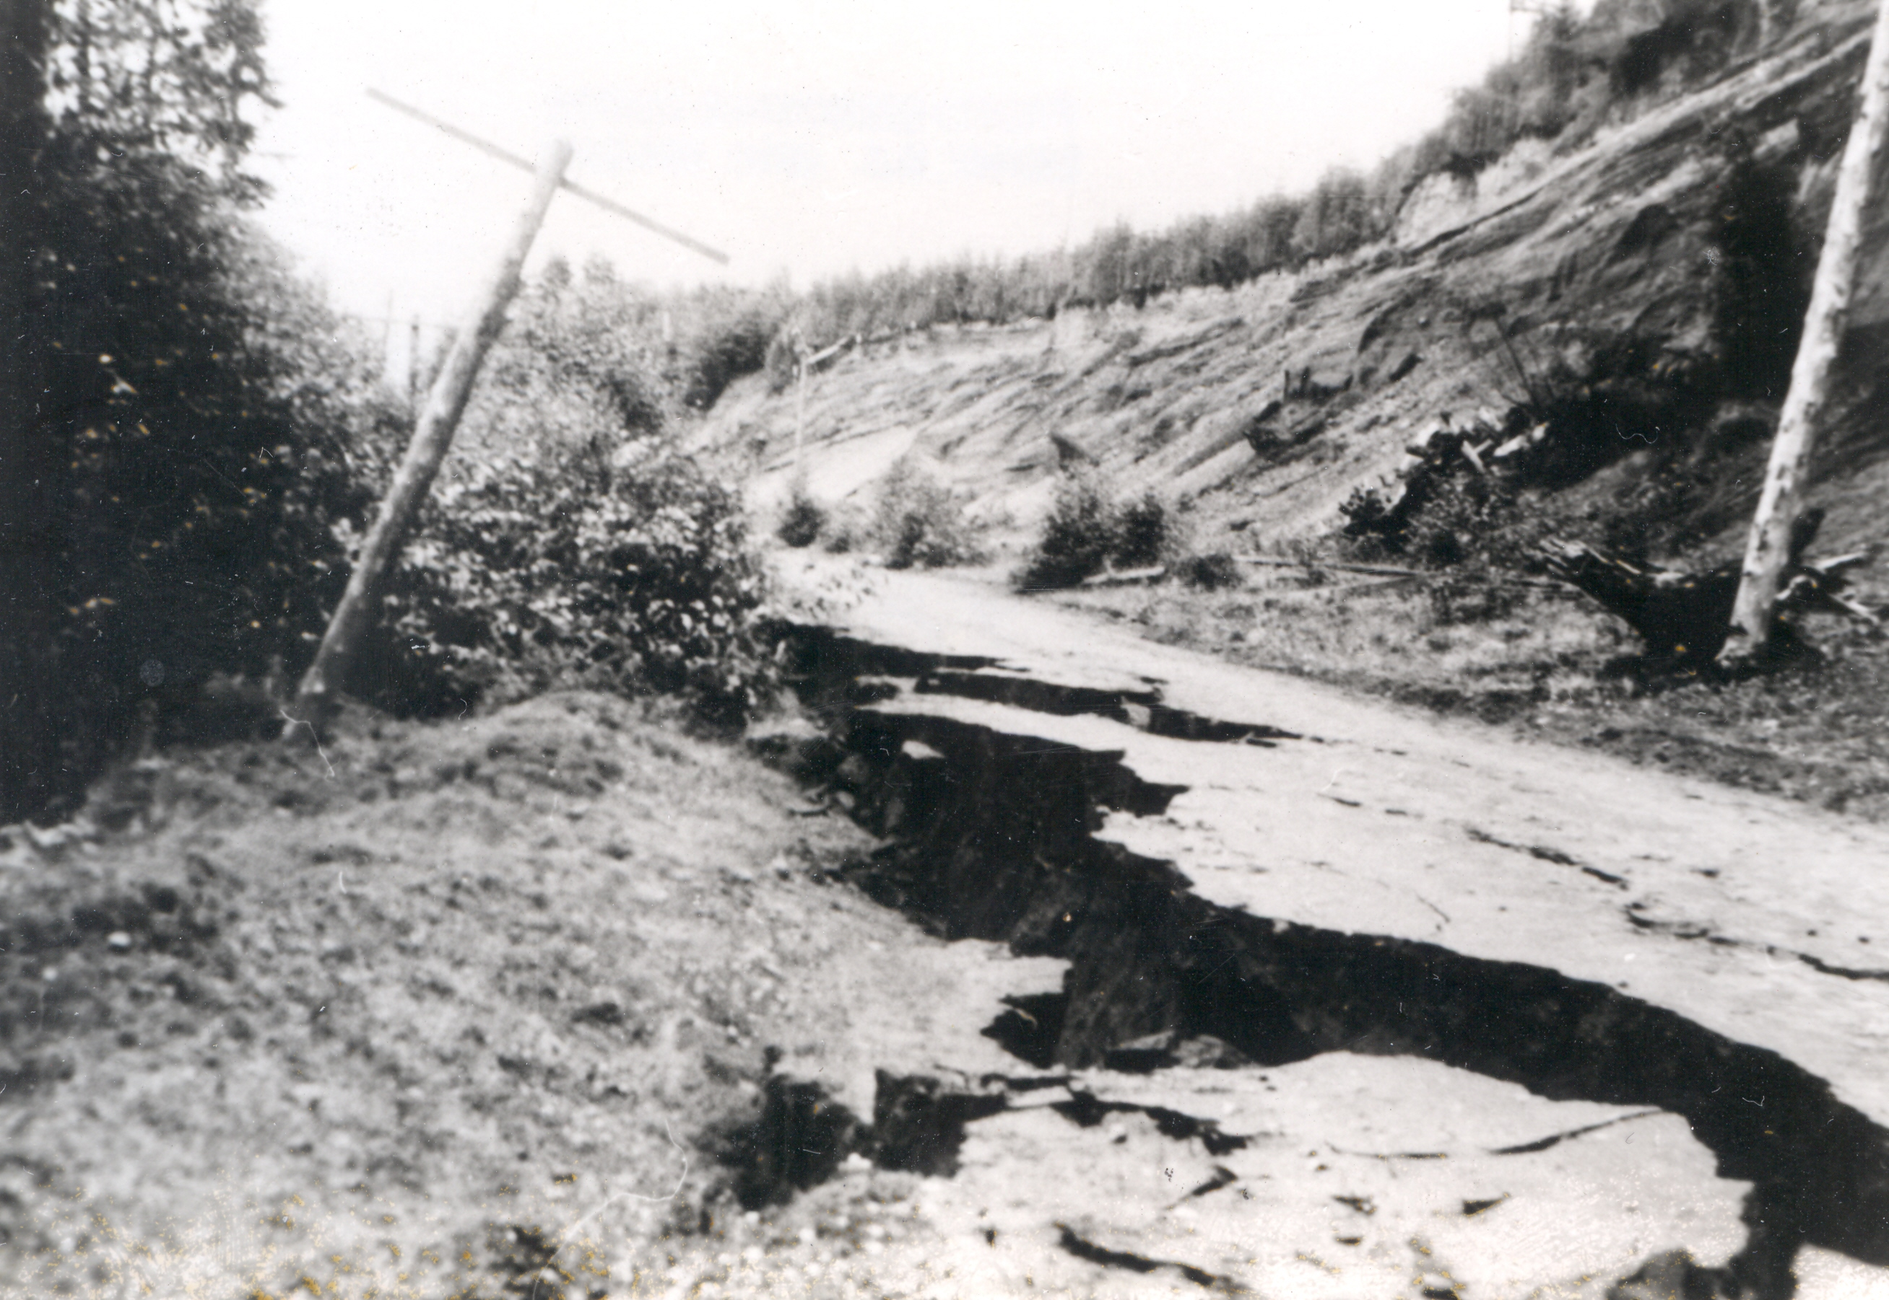
Natural Disasters in Canada
https://science.gc.ca/site/science/en/educational-resources/history-geological-survey-canada-175-objects/67-vancouver-island-earthquake-1946

Slide 5
Natural Disasters in Canada
https://ici.radio-canada.ca/rci/en/news/1993753/damage-from-alberta-tornado-ranks-it-among-strongest-in-canadas-history

Slide 6
Natural Disasters in Canada
https://www.abc.net.au/news/2023-08-21/canada-wildfires-what-we-know/102754712

Slide 7
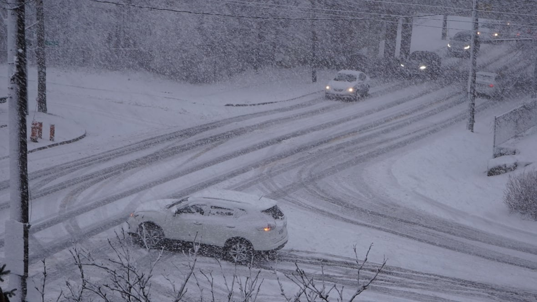
Natural Disasters in Canada
https://www.cbc.ca/kidsnews/post/watch-the-beauty-and-destruction-of-ice-storms
https://www.cbc.ca/news/science/2022-top-10-weather-stories-1.6691069

Slide 8
Natural Disasters in Canada
https://blog.response.restoration.noaa.gov/great-alaska-earthquake-and-tsunami-better-prepared-today

Slide 9
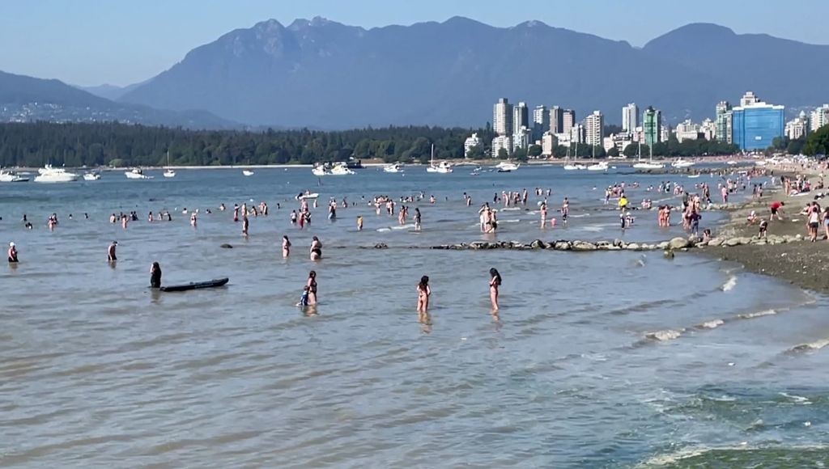
Natural Disasters in Canada
https://www.cbc.ca/news/canada/toronto/heat-warning-toronto-humidex-values-hot-humid-1.4709925
https://vancouver.citynews.ca/2023/07/06/bc-heat-warnings-canada-heat/

Slide 10
Natural Disasters in Canada
https://geologyscience.com/natural-hazards/avalanche/avalanche/

